Slide 1

Kick-OFF meeting
SAP 30 / CMRL
27/4/2022

Slide 2
Agenda
Project Background
Expected benefits
Objectives and KPIs
The Project Team
Project stakeholders
Roles & Responsibilities: RACI
The Steering Committee
The project phases
Macro Planning
Initial Risks
Project budget
Governance
Next Meetings

Slide 3

Project Background
Our Regional Assembly Center in Lille must switch to SAP
The costs of CMRL's IT systems are excessively high
Integration with Headquarters systems as well as multiple corrections are extremely manual (2 full-time resources)
The systems are no longer maintained and do not support our expansion plans
The risks of negative control and audit are very high
The Management Committee examined our feasibility study and approved the creation of the SAP 30 / CMRL project under the following conditions:
Estimated budget of 515,000 euros
Delivery end of November 2022
Closure of 2022 books on the new system
The system must support the CMRL production increase project (CMRL 2022/88)

Slide 4

Expected benefits
Improve productivity
Reduce maintenance costs
Improve user experience
Improve reliability and data protection
* see "Business Case" for quantified benefits

Slide 5
Objectives and KPIs
All current functionalities will be replaced by central systems on December 31, 2022
The old systems will be disconnected on January 1, 2023.
The annual closing of the CMRL will be done on the SAP system before January 7, 2023.

Slide 6
Objectives and KPIs (continued)
KPI | Target
Implementation budget | 515 K euros
Annual operating cost | 310 K euros
Removal of the 2 units assigned to daily corrections | Re-assignments
Commissioning | 6 months
Return On Investment | 1 year
Internal customer satisfaction | 90%
External customer satisfaction | 100%

Slide 7







Project team
SAP EXPERTS Sales
SAP EXPERTS Purchases
Jean ALBERT
SAP Purchasing Coordinator
Denise
ATTALI SAP Sales Coordinator
Olivier ROBESPIERRE
Sponsor
MARIE BERTHELETTE Executive assistant
Chantal DUPONT Chef de Projet
Monique DAVANT SAP Finance Coordinator
Eric Duteil SAP Logistics Coordinator
SAP EXPERTS Finance
SAP EXPERTS Logistic

Slide 8
Project stakeholders
Internal services
External partners
Suppliers
Purchasing
Auditors
SAP
Marketing/Sales
HP
Logistics
Finance
DSI

Slide 9
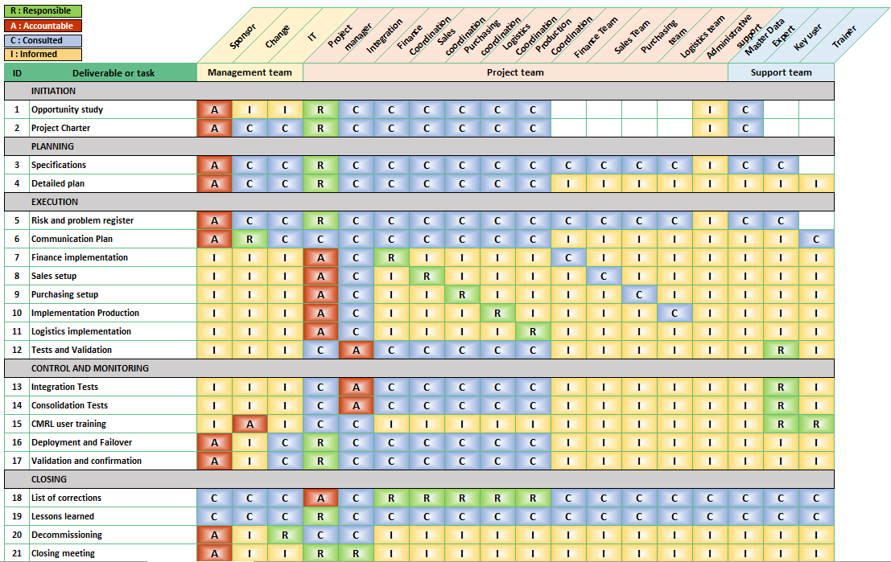
Roles & Responsibilities : RACI Matrix
* see document "RACI Matrix" for more details

Slide 10

The Steering Committee
Gilles PUCCINI – CEO
Headquarters
Daniel CHÂTEAU – IT Director
Chantal DUPONT –Project manager
Thierry GAVEAU –CMRL Director
Olivier ROBESPIERRE – CMRL Finance Director and Sponsor
CMRL
Jacques MEUNIER – CMRL Administrative Manager and Integration / Training
To be defined–Change and Communication Manager

Slide 11





The project phases
Initialization
Opportunity Study
Project charter
Planning
Detailed Requirements and Detailed Plan
Realization
Configuration of CMRL specifics, tests and validations
Control and monitoring
Consolidation tests
Deployment
Failover / validation
Project Closure
Financial close 2022 on SAP and shutdown of old systems
Project closing meeting
MARCH-APRIL
MAY-JUNE
JULY-SEPTEMBER
OCTOBER-DECEMBER
JANUARY 2023

Slide 12
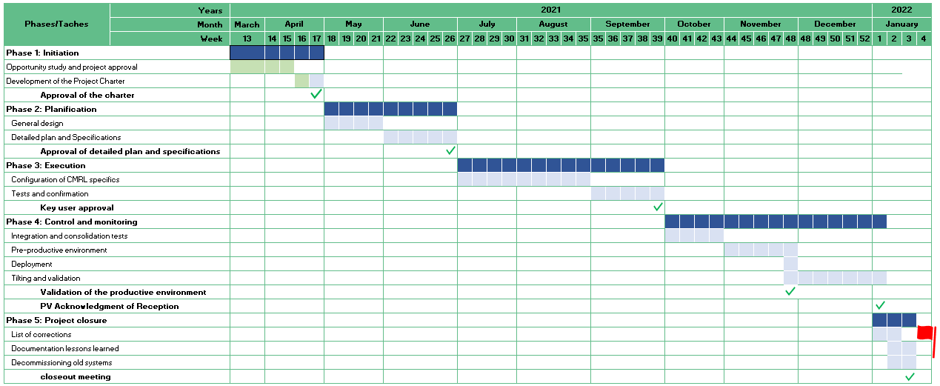
Macro Planning

Slide 13
Initial Risks Register
Description | Gravity | Probability | Criticality | Consequence if happen | Preventive actions | Corrective actions
Status-Quo | Catastrophic | Unlikely | Very critical | Costs, deadlines, strategy | Start of the SAP CMRL project | Start of the SAP CMRL project
Control / Audit | Severe | Likely | Very critical | Costs and deadlines | Accelerated SAP implementation | Agreements with auditors
Lack of support or interest | Major | Unlikely | Critical | Deadlines and Quality | Communication plan and assignment of a change manager | Transparent communication
Dependencies between projects | Major | Likely | Critical | Cost, deadlines, strategy | SAP project and CMRL expansion project in the same portfolio | Change management
Deadline December 2022 | Major | Improbable | Moderate | Cost, deadlines, strategy | Accelerated SAP implementation | Work during public holidays
* see "Risk register" for more details

Slide 14
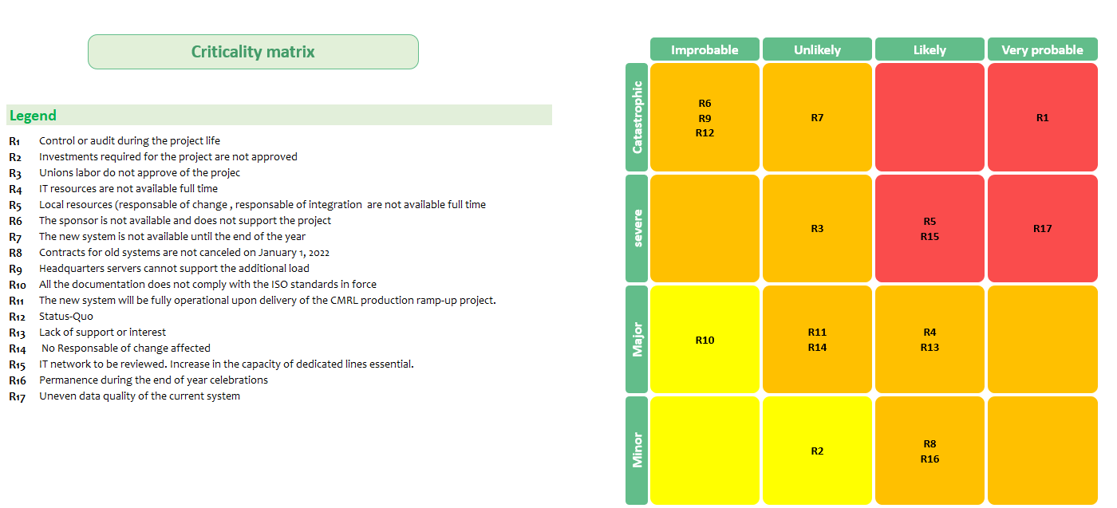
Initial Risks Analysis: Risk matrix
* see "Risk register" for more details

Slide 15
Project Budget
Budget BUILD (Set up cost) |  |  |  | Budget RUN (Annual operating cost)
Internal HR | RH of service providers | Equipment | Licenses | TMA | Licenses
115K€ | 300K€ | 50K€ | 50K€ | 110K€ | 200K€
Total Build = 515 K€ |  |  |  | Annual Operating Cost= 310 K€

Slide 16

Project Governance (1/3)
Weekly project committee
Mission: Monitor the project execution, risks, action plan …
Participants list
Chantal DUPONT
Jacques MEUNIER
Olivier ROBESPIERRE
To be confirmed (Change and communication Manager)
SAP process coordinators

Slide 17

Project Governance (2/3)
Weekly technical committee
Mission: Address technical matters, develop the architecture diagram …
Participants list
Chantal DUPONT
Jacques MEUNIER
Denise ATTALI
Monique DAVANT
Eric DUTEIL
Jean ALBERT
SAP experts in IT

Slide 18

Project Governance(3/3)
Steering committee
Mission: Monitor the overall progress of the project, arbitrate change requests, make strategic decisions
Participants list
Chantal DUPONT
Jacques MEUNIER
Olivier ROBESPIERRE
To be confirmed (Change and Communication Manager)
SAP process coordinators
Gilles PUCCINI (Chief Executive Officer Confassis)
Thierry GAVEAU ( CMRL Director)
Daniel CHÂTEAU ( IT Director)

Slide 19

Questions
Each question helps us to improve
Your next question may help us to prevent unnecessary mistakes
Open and transparent communication is essential for the success of projects

Slide 20
Next meetings
Here are the dates of the next meetings
First project committee, Friday, May 7, 2022 at 9:00 a.m.
First technical committee, Monday, May 10, 2022 at 3:00 p.m.
First steering committee, Friday May 28, 2022 at 11:00 a.m.
The next Management Board meeting will take place on 29 June 2022
Will take place every Friday at the same time
Will take place every Monday at the same time
Will take place every last Friday of the month at the same time
The Management Board will meet at each major milestone
The management Board will then give its opinion on the continuation of the project.

Slide 21
Additional topics proposed
The main documentation of the projects (Contract, Spec, SLA, PAQ, PMP etc.)
The project set-up and rules: the way the team exchanges (email / instant messaging)
the reporting methods, etc…

